Slide 1
Book Recommender Systems
BY
Abhishek Kumar Mishra
Individual Project

Slide 2
Content
Objective
Problem Statement
Data Summary
Analysis Of data
Data Cleaning
Outlier Treatment
Imputing missing value
Difference recomendation system
Challenge
Conslusion
Future Scope

Slide 3
Objective
The main objective is to create a book recommendation system for user.

Slide 4
Problem Statement
During the couple of year, with the rise of Youtube, Amazon, Netflix etc., using of recommender systems. In e-commerce feild we suggest (to buyers articles that could interest them) to online advertisement (suggest to users the right contents, matching their preferences), recommender systems are today use in our daily online journeys.
In simple way we can ellaborate, recommender systems are algorithms aimed at suggesting relevant items to users (items being movies to watch, text to read or anything depending on industries).
Recommender systems are really critical in some industries as they can generate a huge amount of income.

Slide 5
Data Summary
Data set have three file :
    User data set , Book data set and Rating data set.
User data set contain :
    User Id ,
    Location,
    Age
Book data set contain :
    ISBN,
    Book tittle,
    Book Author ,
    Year of Publication ,
    Publiser
Rating data set contain :
    User Id,
    ISBN

Slide 6
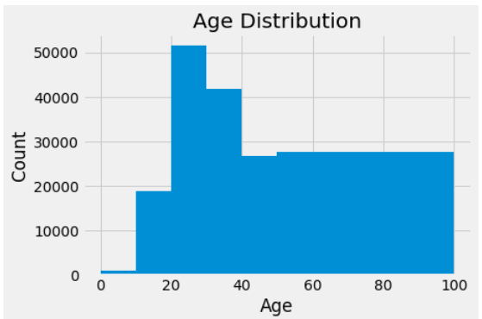
User data set In Age distribution
Most active readers lie in age group 20- 40

Slide 7
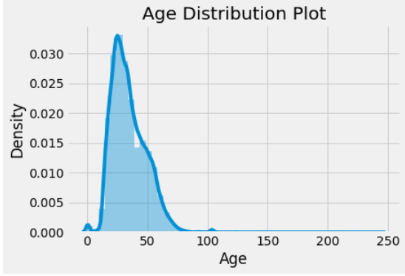
User data set In Age distribution
Age range given here is from 0 To 250

Slide 8
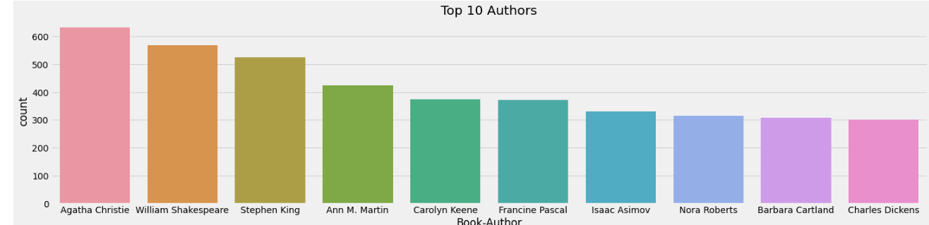
Observations of top 10 Authors
Agatha Christie wrote highest number of books.

Slide 9
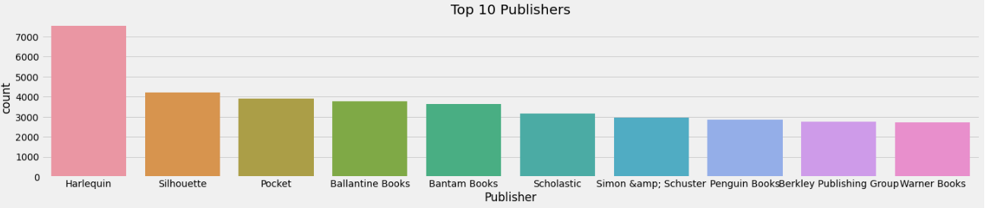
Observations of top 10 Publishers
Harlequin published highest number of books.

Slide 10
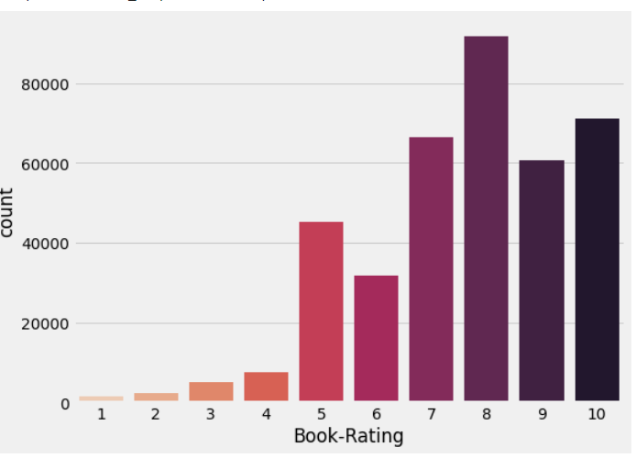
Observations of Booking rate
● Rating 8 has been rated the highest number

Slide 11
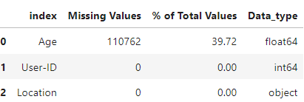
Data Cleaning
Age column has 39.72% missing values

Slide 12
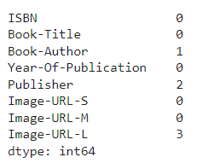
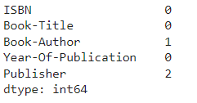
Data Cleaning

Slide 13
Different Models
Popularity Based Recommendation
Book weighted average formula:
Weighted Rating(WR)= [vR/(v+m)]+[mC/(v+m)]
Where,
v : number of votes for the books;
m : minimum votes required to be listed in the chart;
R : average rating of the book; and
C : is the mean vote across the whole report.

Slide 14
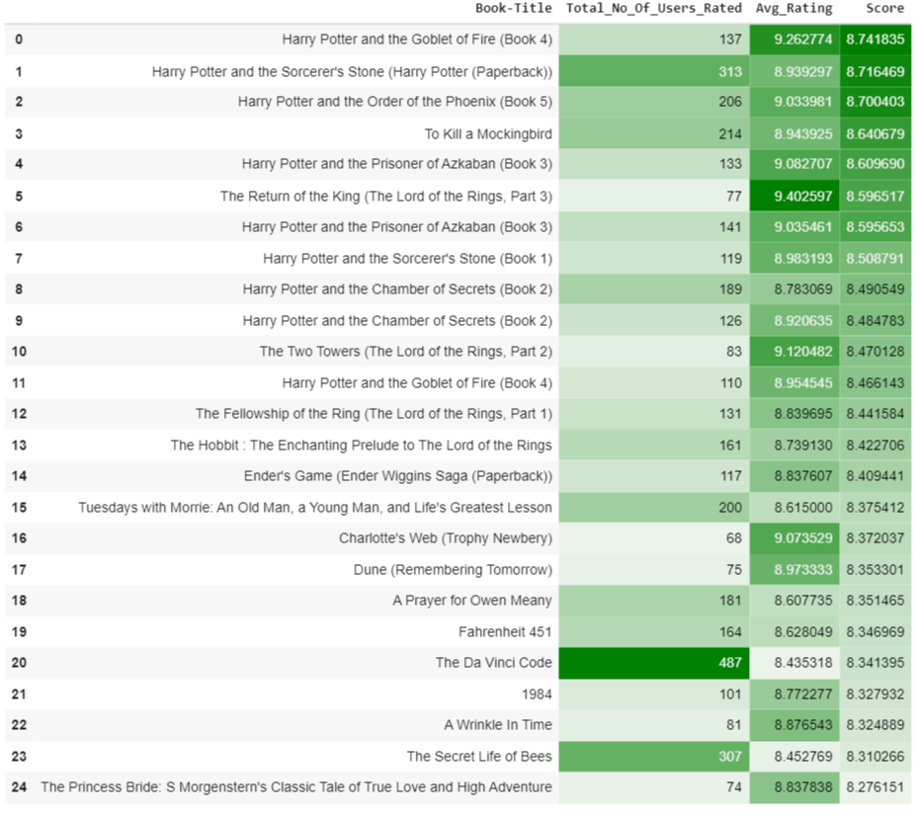
Different Models

Slide 15
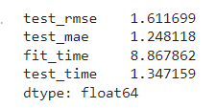
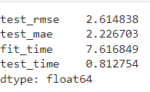
Different Models
SVD
NVM

Slide 16
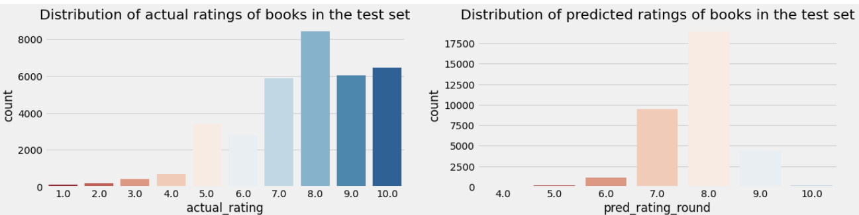
Different models
SVD Model Results

Slide 17
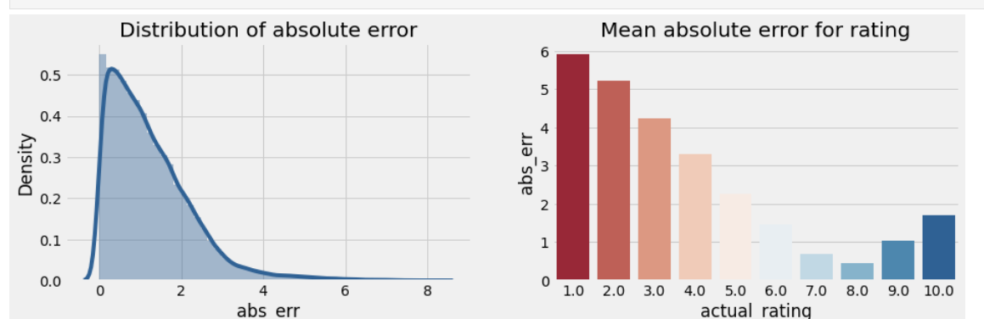
Different Model
SVD model Result

Slide 18
Collaborative Filtering-(Item-Item based)
Collaborative Filtering-(Item-Item based)
Cosine Similarity
Nearest Neighbour

Slide 19
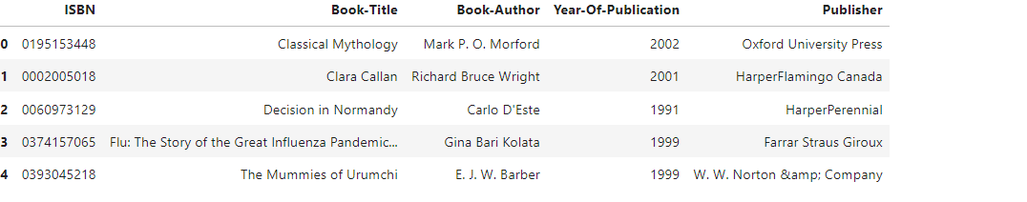
Collaborative Filtering-(User-Item based)

Slide 20
Conclusions
In EDA, the Top-10 most rated books.
Majority of the readers were of the age bracket 20-35
Most of them came from North American and European countries namely USA, Canada, UK, Germany and Spain.
Ratings distribution, most of the books have high ratings with maximum books being rated 8.
Ratings below 5 are few in number.
The modelling, it was observed that for model based collaborative filtering SVD technique worked way better than NMF.

